Slide 1

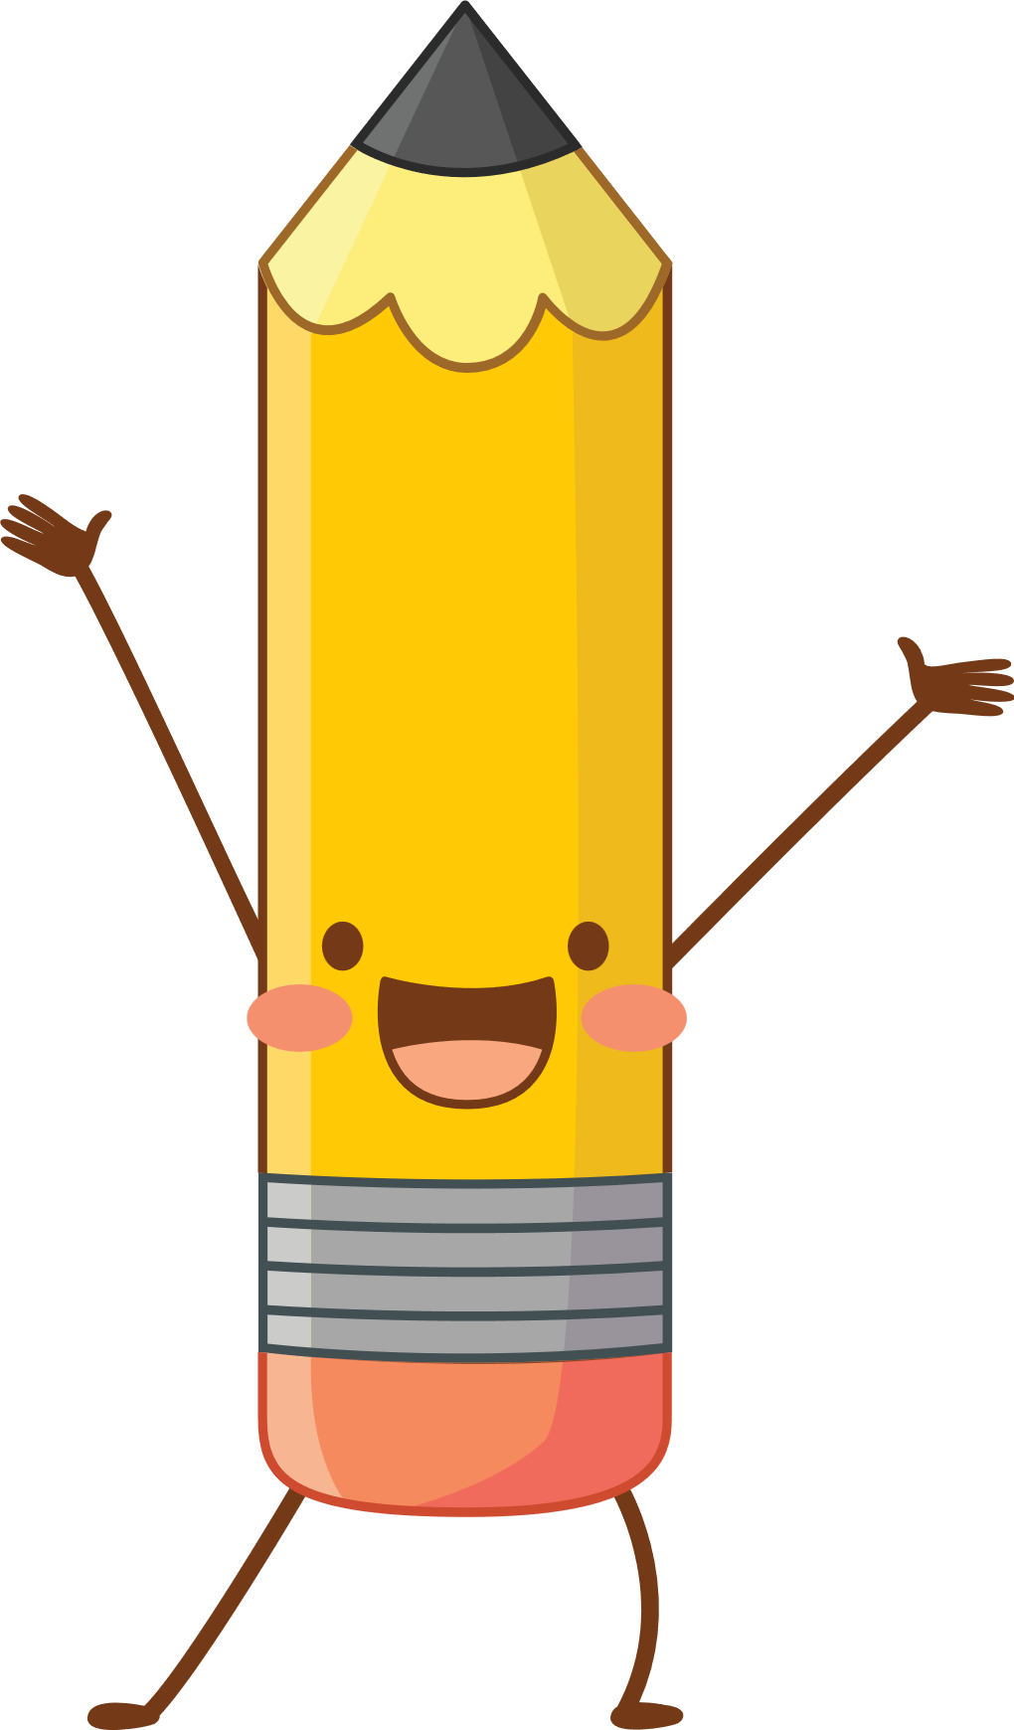

Dr. Babasaheb Ambedkar Khadi Gramodyog Sangh Mangalwada Sanchalit Shrimati Geeta Bankar Mahila Shikshan Shastra Mahavidyalaya Sangola.
Student’s Name :- Puja Kondubhairy. Class:- B.Ed Ist Year 2023-2024 Inspiration name :- Grande.s.k sir. Guide name:- Kore Madam. Year :– 2023-2024

Slide 2

Parts of Speech
Student’s Name :- Puja Kondubhairy.

Slide 3
8 PARTS OF SPEECH!
Noun
Pronoun
Verb
Adjective
Adverb
Conjunction
Preposition
Interjection

Slide 4

What are parts of speech?
Definition : Words that label the various kinds of words in a sentence.
A word’s meaning & position in a sentence determine what part of speech it is.
Some words change depending on the context. Ex. Ride can be a verb or noun.

Slide 5
Noun
Functions
Examples
Words that name persons, animals, places, things or ideas
Proper nouns name particular people, animals, places, or things – they are almost always capitalized
Singular or plural form
Women, desk, teacher, student, bear, mountain, personality. Religion, city, country, happiness
Ms. Schonhar, Greer middle college, California, Mt. Everest, Furman University, Etc.
Girls(singular) vs. girls(plural)

Slide 6
Noun Practice
Kolkata is the capital of West Bengal.
The Royal Bengal Tiger is Found in the Sundarbans.
The Jury gave a unanimous verdict.
Laughter is good for health.
The crowd is very big.
The elephant is an intelligent animal.
The Ganges is a sacred river.
The bravery of the soldier saved the day.

Slide 7

Pronouns
Pronouns are essential components of language that replace nouns to avoid repetition and clarify meaning.
Replacement of Nouns: Simplifies sentences
(e.g., "Maria loves her dog.")
Clarification: Specifies which noun is referred to (e.g., "When Sarah saw Jessica, she waved.")
Indicating Ownership: Shows possession
(e.g., "That book is mine.")

Slide 8
Types of Pronoun
Types of Pronouns
I, you, he, she, it, we, they
Personal Pronouns
my, your, his, her, its, our, them
Possessive Pronoun
myself, yourself, himself, etc.
Reflexive Pronoun
this, that, these, those
Demonstrative Pronoun
who, what, which
Interrogative Pronoun

Slide 9
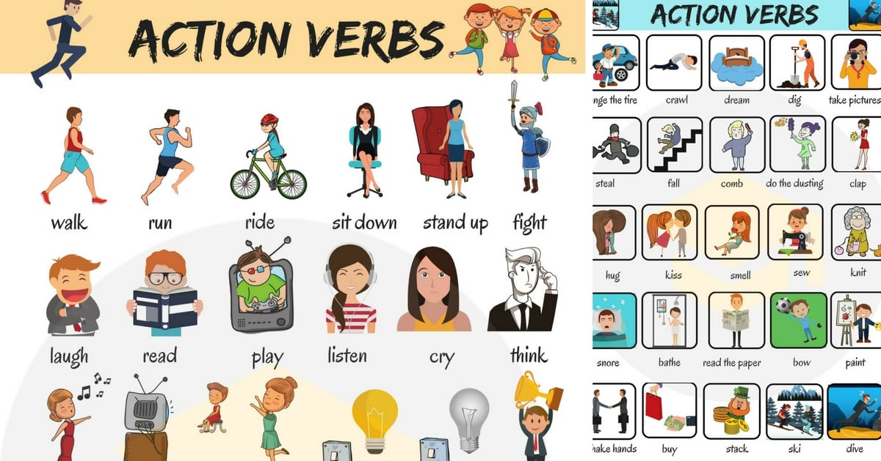
Verbs
A verb is a word that expresses an action, occurrence, or state of being.
Functions of Verbs
Express Action:
Describe what a subject is doing (e.g., run, jump,)
Express State of Being:
Describe what a subject is (e.g., am, is, are)
Express Possession:
Describe what a subject has (e.g., has, own)

Slide 10

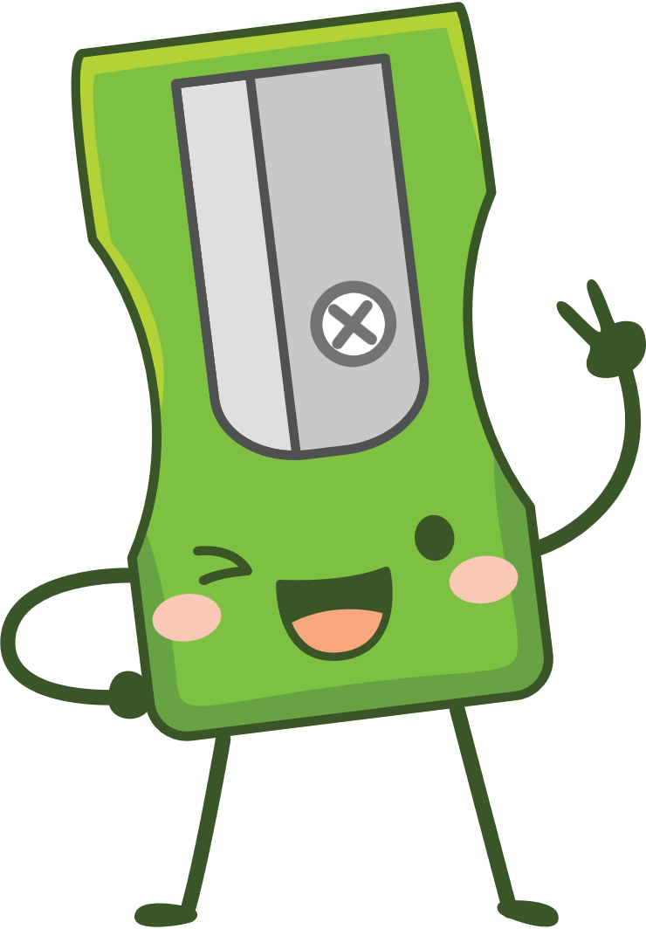





Type of verbs?
Action Verbs: Describe physical or mental actions
Linking Verbs: Connect the subject to additional information
Helping Verbs: Assist other verbs to form verb phrase
Transitive Verbs: Require a direct object to complete their meaning
Intransitive Verbs: Do not require a direct object
Regular Verbs: Form past tense by adding –ed

Slide 11
Adjectives
An adjective is a word that describes or modifies a noun or pronoun, providing additional information about its qualities, quantities, or characteristics.
Functions of Adjectives
Descriptive: Provides details about a noun (e.g., color, size).
Quantitative: Indicates quantity or number (e.g., some, five).
Demonstrative: Points out specific nouns (e.g., this, those).
Possessive: Shows ownership (e.g., my, their).

Slide 12
Types of Adjectives with Example
Descriptive Adjective: "The blue car is fast."
Quantitative Adjective: "I have three apples."
Demonstrative Adjective: "I want that book."
Possessive Adjective: "This is my pen."

Slide 13
Adverbs
Definition :An adverb is a word that modifies or describes a verb, an adjective, another adverb, or even an entire sentence, providing additional information about how, when, where, or to what extent something occurs.
Functions of Adverbs
Modify Verbs: Describe how an action is performed.
Modify Adjectives: Provide more detail about a quality.
Modify Other Adverbs: Indicate the degree of another adverb.
Modify Sentences: Convey the speaker's attitude toward the entire statement.

Slide 14
Adverbs
Examples: -
Modifying a Verb: "She sings beautifully.”
Modifying an Adjective: "He is very tall.”
Modifying Another Adverb: "She ran extremely quickly.“
Modifying a Sentence: "Fortunately, it didn’t rain.”

Slide 15
Conjunctions
Definition of a Conjunction
A conjunction is a word that connects words, phrases, or clauses in a sentence, helping to form complex and coherent ideas.
Functions of Conjunctions
Coordinating Conjunctions: Join elements of equal grammatical rank (e.g., words, phrases, independent clauses).
Subordinating Conjunctions: Connect an independent clause with a dependent clause, indicating relationships like cause and effect or contrast.
Correlative Conjunctions: Work in pairs to join equal elements (e.g., either/or, neither/nor).

Slide 16
Examples of a Conjunctions
Coordinating Conjunction:
"I wanted to go for a walk, but it started raining."
Subordinating Conjunction:
"Although it was late, we decided to continue the meeting."
Correlative Conjunction:
"Either you finish your homework, or you can't go out."

Slide 17
Example of a Prepositions
She walked to the store
Direction
The meeting is at 3 PM
Time
The cat is on the roof.
Place
The park is between the library and the school
Spatial Relationship

Slide 18
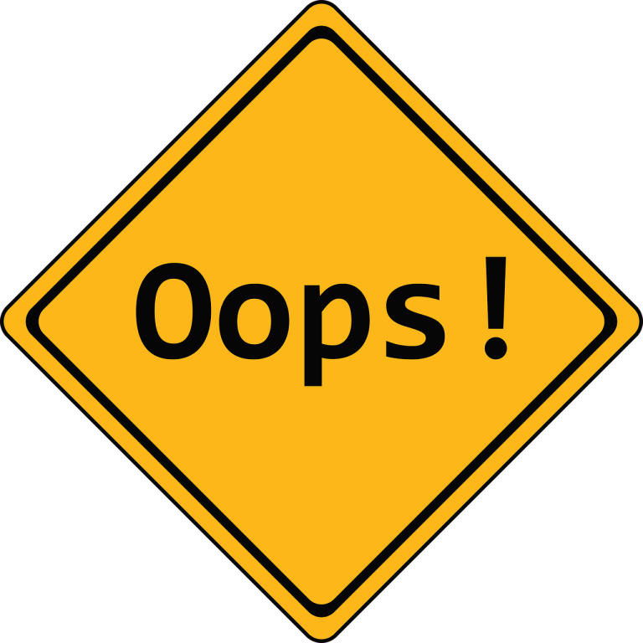
Interjections
An interjection is a word or phrase used to express a sudden emotion or feeling, such as surprise, joy, anger, or disgust. Interjections are not grammatically connected to the rest of the sentence and are often used in informal speech and writing.

Slide 19
Functions of Interjections?
Express emotion: Interjections allow us to convey strong feelings and reactions. Examples include "Wow!" to express amazement, "Ouch!" to express pain, and "Yay!" to express joy.
Grab attention: Interjections can be used to demand attention or emphasize a point. For example, "Hey!" or "Listen up!"
Represent sounds: Some interjections mimic sounds, such as "Shh!" to indicate silence, "Ugh!" to express disgust, or "Hmm..." to indicate contemplation.

Slide 20
Types of interjections
Primary interjections: Words or sounds that can only function as interjections, such as "Oops!", "Aha!", or "Psst!"
Secondary interjections: Words that normally function as other parts of speech but can also be used as interjections, such as "Bravo!", "Alas!", or "Congratulations!"

Slide 21
Thank You

